Slide 1
Tutorial and Workshop on Semantic Computing with Big Data (TWSCBD2019) PART TWO
David A. Ostrowski
Global Data Insight and Analytics
Ford Motor Company

Slide 2


Overview
Spark Stack Overview
Spark / Scala Introduction
Scala Basics
RDD operations
Spark SQL
Standalone applications with Scala
Streaming Spark
MLIB
GraphX

Slide 3
Spark
Another engine for large-scale processing
Implemented in Scala
Support for Scala, Java ,Python, R , (Julia soon)
Documented speed is an order of magnitude faster than pig, hive (10-20X)

Slide 4
Spark (cont.)
General purpose
Allows for interactive queries / programming as well as stream processing
Tight integration bet. Core and libraries
Core more strongly supports SQL and ML programs speed up as well
Cleaner than alternatives : pure Java, PIG with UDFs, etc.

Slide 5
Spark (cont.)
Spark does NOT require Hadoop!
It provides support for storage systems implementing the Hadoop APIs
Includes local file system, Amazon S3, Cassandra, Hive, Hbase
Spark supports text files, SequenceFiles, Avro, Parquet and any other hadoop InputFormat

Slide 6
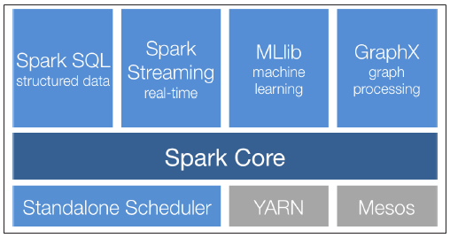
Spark Stack

Slide 7
Spark Overview Spark Core
Basic Functionality of Spark
Task scheduling
Memory Management
Fault recovery
Interaction with Storage Systems
Resilient Distributed Datasets (RDD) API
Spark’s main programming paradigm
RDDs represent a collection of items distributed across many compute nodes that can be manipulated in parallel

Slide 8
Spark Libraries Spark SQL (Formerly Shark)
Spark’s package for working with structured and unstructured data
Provides three main capabilities:
It can load data from a variety of structured sources (e.g. JSON, Hive and Parquet)
Rich integration between SQL and regular Python/ Java/ Scala code, including the capability to join RDDs and SQL tables, expose custom functions
Also allows one to query the data using SQL from external tools through standard database connections (JDBC/ ODBC) including Tableau
Also easy to use!

Slide 9
Spark Libraries Spark Streaming
A Spark component that enables processing live streams of data
Not to be confused with Hadoop-based Streaming I/O
This technology enabled others to stream in data to any program with standard I/O based stream
This is designed specifically among the spark based languages to manage real-time streams of data (large collections)
While fun to use – you do not have as much of a need in the Spark environment as you already have the power of three different Turing-Complete languages to choose from and SQL !
Examples:
Core’s RDD API makes it easy for programmers to learn the project and move between applications that manipulate data stored in memory, on disk or arriving in real time

Slide 10
Spark Libraries MLIB
MLIB provides multiple types of machine learning algorithms
All are scalable across a cluster
A set of functions called directly in Scala that can be applied to a data collection
Allowing for you to call various functions on Distributed data sets and provide for immediate comparison
Completely integrated as a library to be imported in your code (easy to use)

Slide 11
Spark Libraries GraphX
A library that provides an API for manipulating graphs and performing graph-parallel computations
GraphX extends Sparks RDD API , allowing one to create a directed graph with arbitrary properties.
Same as MLIB, called directly as functions which allow for the means of supporting graph representation as well as operations

Slide 12
What is Scala – why do we want it?
Scala is a language that has gained traction lately (even before Spark) due to
Strongly typed
JVM Language
All code is converted to bytecode
Platform independence of Java
Can leverage Java API
Perhaps reach the potential of Jython
Support ‘Scaling up’ due to being strongly typed and high support for functional programming
Spark is written in 20,000 lines of Scala

Slide 13
What is Scala – More Reasons
Highly Object Oriented
Between Java and SmallTalk / Squeak
Very Condense (no code bloat associated with Java)
Expressive
First Class functions
Pass as parameters
Used in anonymous fashion
Stored in containers
…
Concise
Type Inference
Literal Syntax for function creation

Slide 14
What is Scala – More Reasons
Java interoperability
Can reuse java libraries
Can reuse java tools
No performance penalty

Slide 15
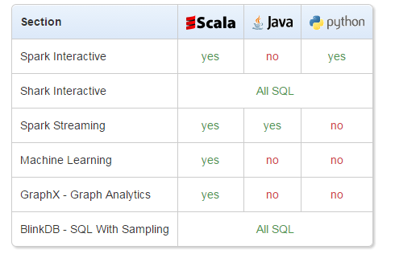
What is Scala – More Reasons

Slide 16
Why Scala
Functional / Parallel
Best support
Concise
Interpretive Prompt
Much more :
Karau, Holden, et al. Learning spark: lightning-fast big data analysis. " O'Reilly Media, Inc.", 2015.
Karau, Holden, et al. High Performance Spark : Best Practices for Scaling & Optimizing Apache Spark, " O'Reilly Media, Inc.", 2016.

Slide 17
Running Scala through Spark interpretive prompt
All examples in Scala/Spark are managed in the interpretive prompt
To start the spark interactive prompt type “spark-shell” within the bin directory
After logging on – change directory to the spark home directory:
ubuntu@ip-172-31-21-139:~$ cd spark-2.1.0-bin-hadoop2.7/
From the home directory run the startup shell script as follows:
/spark-2.1.0-bin-hadoop2.7$ ./bin/spark-shell
You can then cut/paste the code directly into the “spark” interpretive prompt

Slide 18
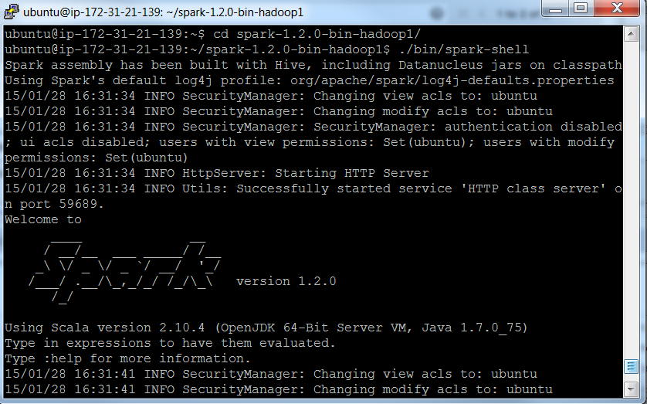
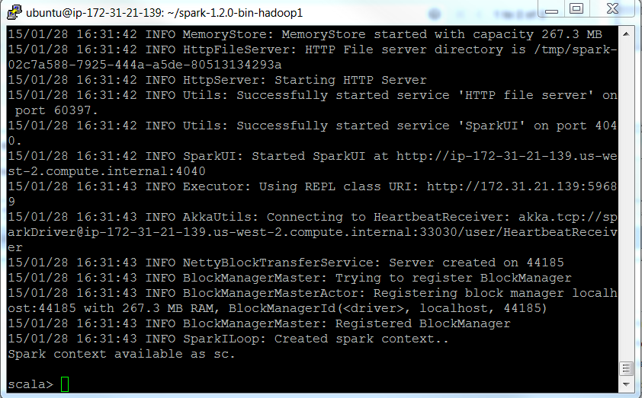
Running Scala through Spark interpretive prompt
All examples in Scala/Spark are managed in the interpretive prompt
Again, present the screen as to what exactly the spark prompt will look like………

Slide 19
Scala (typed directly into the Spark/Scala Shell)
//Default variables are assigned to any expressions
scala>8 * 5 + 2
Res0: Int = 42
Scala>0.5 * res0
Res1= Double = 21.0
//All simple data types are objects
scala>”Hello, “ + res0
Res2: java.lang.String = Hello, 42
scala>10.toString()
Res2: String = 10

Slide 20
Scala (typed directly into the Spark Shell)
scala> var a = 100
a: Int = 100
scala> var b = 50
b: Int = 50
scala> a.+(b)
res7: Int = 51 //you can consider , the ‘+’ operator as a method
//a ‘method’ b as a shorthand for a.method(b)
scala>val myVal: String = “Foo”
keyword “val” this means that a variable cannot change value (immutable variable)
scala>var myVar:String = “Foo”
the keyword var means that it is a variable that can be changed (mutable variable)

Slide 21
Scala
When you assign an initial value to a variable , the Scala compiler can figure out the type of the variable based on the value assigned to it (variable type inference)
myVal = "test" // gave an error
myVar = "test" // can change
If stmt
scala>val x = 20;;
scala>If (x < 21){
scala> - println(“x is less than 21”);
scala> - }else{
scala> printlin(‘ x is greater than or equal to 21’);
scala>}

Slide 22
Scala
scala> val myNumbers = List(1,2,3,4,5,4,3)
myNumbers: List[Int] = List(1, 2, 3, 4, 5, 4, 3)
NOTE: The “<-” implies iteration through a collection – like I python saying for item in list:
scala> for (num <- myNumbers)
| println(num)
1
2
…
scala> for (i <- 1 to 10)println(i)
1
2
3
…

Slide 23
Scala
scala> var count = 0
count: Int = 0
scala> do {
| count += 1
| println(count)
| } while(count < 10)
1
2
.
.
10

Slide 24
Scala functions: background
With Java, C++ etc. you are programming in an imperative style (you give one imperative command at a time, iterate with loops and mutate state shared between different functions)
Scala allows you to program imperatively as well as in a more functional style.
In Scala, functions are first-class constructs, this is evidenced by the following application of a function passed as an argument

Slide 25
Scala functions: background
One concise means of printing a list
scala> var myVar = List(1,2,3)
myVar: List[Int] = List(1, 2, 3)
scala> myVar.foreach((arg: Int) => println(arg))
1
2
3

Slide 26
Scala functions: background
One concise means of printing a list
scala> var myVar = List(1,2,3)
myVar: List[Int] = List(1, 2, 3)
scala> myVar.foreach((arg: Int) => println(arg))
scala>List(1,2,3).foreach((arg: Int) => println(arg))
scala>List(1,2,3).foreach(println)

Slide 27
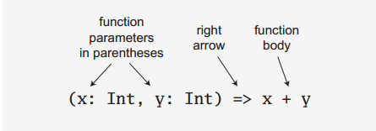
Scala functions: background
The prior examples demonstrate a ‘function literal’ using the ‘=>’ reserved word (simply referenced as a ‘right arrow’)
Here is a breakdown of the function literal syntax:

Slide 28
Scala functions: background
In an effort to guide you into a functional direction a functional relative of the imperative ‘for’ is available in Scala
scala> for (arg <- List(1,2,3))
| println(arg)
1
2
3
Here, the ‘<-’ operator is interpreted as ‘in’ just as for (arg in List(1,2,3)

Slide 29
Scala functions
scala> def cube(a: Int): Int = a * a * a
cube: (a: Int)Int
scala> myNumbers.map(x => cube(x))
res8: List[Int] = List(1, 8, 27, 64, 125, 64, 27)
scala> myNumbers.map(x => x * x * x)
res9: List[Int] = List(1, 8, 27, 64, 125, 64, 27)

Slide 30
Scala functions
scala> val myNumbers = List(1,2,3,4,5,4,3)
myNumbers: List[Int] = List(1, 2, 3, 4, 5, 4, 3)
scala> def factorial(n:Int):Int = if (n==0) 1 else n * factorial(n-1)
factorial: (n: Int)Int
scala> myNumbers.map(factorial)
res18: List[Int] = List(1, 2, 6, 24, 120, 24, 6)
scala> myNumbers.map(factorial).sum
res19: Int = 183

Slide 31
Scala
scala> var factor = 3
factor: Int = 3
scala> val multiplier = (i:Int) => i * factor
multiplier: Int => Int = <function1>
scala> val l1 = List(1,2,3,4,5) map multiplier
l1: List[Int] = List(3, 6, 9, 12, 15)
scala> factor = 5
factor: Int = 5

Slide 32
Scala functional programming
Take note that _ * 2 is a function literal that is shorthand for i=>i *2. For each argument to the function, you can use _ if the argument is used once
scala> List(1,2,3,4,5) map { _ * 2}
res14: List[Int] = List(2, 4, 6, 8, 10)

Slide 33
Scala functional programming
The first _ represents the argument that is accumulating the value of the reduction and the second _ represents the current value of the list (this will multiply all numbers in a list)
scala> List(1,2,3,4,5) reduceLeft { _ * _ }
res15: Int = 120
NOTE: the code above will iterate through the list and multiply each item in the list with each other
for item in list:
total = total * item

Slide 34
Scala Simple Classes
scala> class Person{
private var privateAge= 0
def age = privateAge
def age_=(newValue: Int){
if (newValue > privateAge) privateAge = newValue;
}
}
scala>val fred = new Person
scala>fred.age =30
scala>fred.age = 21
scala>println(fred.age)

Slide 35
Resilient Distributed Dataset Spark : Programming with RDDs
RDDs are Spark’s core abstraction for working with Data
RDDs are Immutable Distributed Collections of Elements
In Spark , all work is expressed as either creating new RDDs , transforming existing RDDs or calling operations on RDDs to compute a result.
Spark automatically distributes the data contained in RDDs across your cluster and parallelizes the operations you perform on them

Slide 36
Resilient Distributed Dataset Spark : Programming with RDDs
Each RDD is split into multiple partitions which may be computed on different nodes of the cluster
Users create RDDs in two ways
Loading an external dataset
Distributing a collection of objects in their driver program.

Slide 37
Resilient Distributed Dataset Spark : Programming with RDDs
One can load a text file as an RDD of strings using SparkContext.textFile()
NOTE: data can be read in from a number of data sources including HDFS
NOTE: to read in the file as specified you need to be in the Spark home directory
scala> val file = sc.textFile("README.md")
Once created, RDDs offer two types of operations:
Transformations
Actions.
Transformations construct a new RDD from a previous one.

Slide 38
Resilient Distributed Dataset Spark : Programming with RDDs
The filter operation is supported by a function literal where ‘line’ is the paramter list and ‘line.contains(“and”)’ is the function body
scala> val c = file.filter(line => line.contains("and"))
The collect() method will dump the output to the screen
Scala>c.collect()

Slide 39
Resilient Distributed Dataset Spark : Programming with RDDs
Actions compute a result based on an RDD and either return it to the driver program or save it to an external storage system.
Actions force the evaluation of transformations required for the RDD they are called on, since they are required to actually produce output
count gives the number of output lines
scala> c.count()
The following will print out the lines
Scala>println(“input had “ + c.count() + “ lines”)
The take() method will retrieve ‘n’ numbers of the output record
Scala>c.take(10).foreach(println)

Slide 40
Resilient Distributed Dataset Spark : Programming with RDDs
We used take() to retrieve a small number of elements in the RDD at the driver program
We then iterate over them locally to print out information to the driver.
RDDs also have a collect() function to a very small size and you’d like to deal with it locally. Keep in mind that your entire dataset must fit into memory on a single machine to use collect() on it , so collect() shouldn’t be used on large datasets.

Slide 41
Resilient Distributed Dataset Spark : Programming with RDDs
Spark only computes RDDs in a lazy fashion, the first time they are used in an action.
This is for efficiency in terms of big data
computing only the data needed for its result.
Helps when dealing with extremely large files that may not be computed on the same node
In the case of using the ‘first’ method – it is only necessary to read in the very first line of a file, once again, supporting a more efficient operation.

Slide 42
Resilient Distributed Dataset Spark : Programming with RDDs
Spark’s RDDs are by default recomputed each time you run an action on them.
To reuse an RDD in multiple actions, you can ask Spark to persist it using RDD.persist().
We can ask Spark to persist our data in a number of different places.
After computing it the first time, Spark, will store the RDD contents in memory (partitioned across the machines in your cluster) and reuse them in future actions.

Slide 43
Resilient Distributed Dataset Spark : Programming with RDDs
To summarize, every Spark session will work as follows:
1) create some input RDDs from external data
2) Transform them to define new RDDs using transformations like filter()
3) Ask Spark to persist() any intermediate RDDs that will need to be reused
4) Launch actions such as count() and first() to kick off a parallel computation which is then optimized and executed by Spark

Slide 44
Resilient Distributed Dataset Spark : Programming with RDDs
Spark provides two ways to create RDDs, loading an external dataset and parallelizing a collection in your driver program
The simplest way to create RDDs is to take an existing in-memory collection and pass it to SparkContext’s parallelize method
NOTE: not widely used as it requires you to have your entire dataset in memory on one machine
Example:
val lines = sc.parallelize(List(“pandas”, “I like pandas”))

Slide 45
Resilient Distributed Dataset Spark : Programming with RDDs
Basic RDDs – the two most common transformations you will likely be performing on basic RDDs are map and filter.
The map transformation takes in a function and applies it to each element in the RDD with the result of the function being the new value of each element in the resulting RDD.
The filter transformation take in a function and returns an RDD which only has elements that pass the filter function.

Slide 46
Resilient Distributed Dataset Spark : Programming with RDDs
We can use map to do any number of things from fetching the website associated with each URL in our collection, to just squaring the numbers.
With Scala and python you can use the standard anonymous function notation or pass in a function
scala>val input =sc.parallelize(List(1,2,3,4))
scala>val result = input.map(x => x * x )
scala>println(result.collect().mkString(“,”))

Slide 47
Resilient Distributed Dataset Spark : Programming with RDDs
RDDs use key-value pairs which is a common data type required for many operations in Spark
Key-Value RDDs are commonly used to perform aggregations and often we will do some initial ETL to get our data into a key-value format.
Key-value RDDs expose new operations, grouping together data with the same key, and grouping together two different RDDs.

Slide 48
Resilient Distributed Dataset Spark : Programming with RDDs
An advanced feature that lets users control the layout of Pair RDDs across nodes: partitioning.
Using controllable partitioning, applications can sometimes greatly reduce communication costs, by ensuring data that will be accessed together and will be on the same node.

Slide 49
Resilient Distributed Dataset Spark : Programming with RDDs
keys return an RDD of just the keys
values return an RDD of just the values
sortByKey() returns an RDD sorted by the key
subtractByKey() remove elements with a key present in the other RDD
Join() perform an inner join between two RDDs
rightOuterJoin Perform a join between two RDDs where they key must be present in the other RDD
leftOuterJoin Perform a join between two RDDs where the key must be present in the other RDD
Cogroup – Group back together data from both RDDs sharing the same key

Slide 50
Resilient Distributed Dataset Spark : Programming with RDDs
combineByKey (createCombiner, mergeValue, mergeCombiners, partitioner) purpose: combine values with the same key together
groupByKey() group together values with the same key
ReduceByKey(func) combine values with the same key together
mapValues : apply a function to each value of a pari RDD without changing the key
flatmapValues(func) Apply a function which returns an iterator to each value of a Pair RDD and for each element returned produce a key-value entry with the old key

Slide 51
RDD method examples
scala> var rdd1 = sc.parallelize(Seq((1,2),(3,4),(3,6)))
scala> rdd1.keys.collect
res3: Array[Int] = Array(1, 3, 3)
scala> rdd1.values.collect
res5: Array[Int] = Array(2, 4, 6)
scala> var rdd = sc.parallelize(Seq(("math", 50),("math",60),("english",65)))
scala> rdd.keys.collect
res0: Array[String] = Array(math, math, english)
scala> rdd.values.collect
res1: Array[Int] = Array(50, 60, 65)

Slide 52
RDD method examples
scala> var rdd1 = sc.parallelize(Seq((1,2),(3,4),(3,6)))
scala> var rdd2= sc.parallelize(Seq((3,9)))
scala> rdd1.subtractByKey(rdd2).collect
res6: Array[(Int, Int)] = Array((1,2))
scala> rdd1.join(rdd2).collect
res7: Array[(Int, (Int, Int))] = Array((3,(4,9)), (3,(6,9)))

Slide 53
CombineByKey()
val a =
scala>a = sc.parallelize(List("dog","cat","gnu","salmon","rabbit","turkey","wolf","bear","bee"), 3)
scala> val b = sc.parallelize(List(1,1,2,2,2,1,2,2,2), 3)
scala> val c = b.zip(a)
scala> val d = c.combineByKey(List(_), (x:List[String], y:String) => y :: x, (x:List[String], y:List[String]) => x ::: y)
scala>d.collect res16: Array[(Int, List[String])] = Array((1,List(cat, dog, turkey)), (2,List(gnu, rabbit, salmon, bee, bear, wolf)))

Slide 54
RDD key/value operations (average)
scala> val inputrdd_reg = sc.parallelize(Seq(("math", 50),("math",60),("english",65)))
scala> var i2 = inputrdd_reg.mapValues(x => (x,1))
res8: Array[(String, (Int, Int))] = Array((math,(50,1)), (math,(60,1)), (english,(65,1)))
scala> var i3 = i2.reduceByKey((x,y) => (x._1 + y._1, x._2 + y._2))
res9: Array[(String, (Int, Int))] = Array((english,(65,1)), (math,(110,2)))
scala> var i4 = i3.map{ case (key, value) => (key, value._1 / value._2.toFloat) }
res10: Array[(String, Float)] = Array((english,65.0), (math,55.0))

Slide 55
What happened?
sc.parallelize(Seq(("math", 50),("math",60),("english",65))).mapValues(x => (x,1)).reduceByKey((x,y) => (x._1 + y._1, x._2 + y._2)).map{ case (key, value) => (key, value._1 / value._2.toFloat) }.collect
res45: Array[(String, Float)] = Array((english,65.0), (math,55.0))

Slide 56
breakdown
Key value
Key value
Math (50,1)
Math 50
mapValues(x => (x,1))
Math (60,1)
Math 60
English (65,1)
English 65
reduceByKey((x,y) => (x._1 + y._1, x._2 + y._2)
Key value
Key value
Math 65
Math (110,2)
English 65
English (65,1)
map{ case (key, value) => (key, value._1 / value._2.toFloat)}

Slide 57
Do a single sample of the data
scala> var rdd1 = sc.parallelize(Seq((1,2),(3,4),(3,6)))
rdd1: org.apache.spark.rdd.RDD[(Int, Int)] = ParallelCollectionRDD[65] at parallelize at <console>:27
scala> rdd1.reduceByKey((x,y) => x).collect
res46: Array[(Int, Int)] = Array((1,2), (3,4))

Slide 58
RDD example (PI Estimation)
scala>var NUM_SAMPLES=5
scala> val count = sc.parallelize(1 to NUM_SAMPLES).map{i =>
| val x = Math.random()
| val y = Math.random()
| if (x*x + y*y < 1) 1 else 0
| }.reduce(_ + _)
scala>println("Pi is roughly " + 4.0 * count / NUM_SAMPLES)

Slide 59
(estimation of PI ,by “throwing darts” at a circle) random points in the unit square (0,0) to (1,1). The fraction that fall into the circle should be PI / 4.
RDD example (PI Estimation)
.9 * .9 = .81
.81 + .81 = 1.62
Outside the circle
.5 * .5 = .25
.25 + .25 = .5
Inside the circle

Slide 60
RDD example
(PI Estimation)
// create RDD will start with [1,2,3…NUM_SAMPLES]
// start with an RDD containing a list of 1…Numsamples
scala> val count = sc.parallelize(1 to NUM_SAMPLES).
map{i =>
| val x = Math.random()
| val y = Math.random()
| if (x*x + y*y < 1) 1 else 0
| }.reduce(_ + _)

Slide 61
RDD example
(PI Estimation)
//NOTE: I can run the creation of RDD by itself to demonstrate the usage
scala> val count = sc.parallelize(1 to NUM_SAMPLES)
res24: Array[Int] = Array(1, 2, 3, 4, 5)
// NOTE: I can also demonstrate how the map works
scala> val count = sc.parallelize(1 to NUM_SAMPLES).map{i => 0}
res0: Array[Int] = Array(0, 0, 0, 0, 0)

Slide 62
RDD example
(PI Estimation)
//Map a series of evaluated points //between [0,0] and [1,1] to the RDD
// below me create values of x and y between 0 and 1
// the metric in the “if” statement considers if you are in the circle or not.
scala>var NUM_SAMPLES=5
scala> val count = sc.parallelize(1 to NUM_SAMPLES).map{i =>
| val x = Math.random()
| val y = Math.random()
| if (x*x + y*y < 1) 1 else 0
| }.reduce(_ + _)

Slide 63
RDD example
(PI Estimation)
Running with small example sizes can produce inaccurate output
Scala>var NUM_SAMPLES=5
scala> val count = sc.parallelize(1 to NUM_SAMPLES).map{i =>
| val x = Math.random()
| val y = Math.random()
| if (x*x + y*y < 1) 1 else 0
| }
// possible output would be (where 0 indicates outside of the circle and 1 indicating inside the circle)
res0: Array[Int] = Array(0, 1, 1, 0, 1)

Slide 64
RDD example
(PI Estimation)
scala> val count = sc.parallelize(1 to NUM_SAMPLES).map{i =>
| val x = Math.random()
| val y = Math.random()
| if (x*x + y*y < 1) 1 else 0
| }.reduce(_ + _)
The ‘reduce’ here would sum everything in the array.
Finally the following calculation will produce the PI estimate
println("Pi is roughly " + 4.0 * count / NUM_SAMPLES)

Slide 65
Dataframes, datasets, RDD
A dataframe is a table (or two dimensional array-like structure) in which each column contains measurements on one variable and each row contains one case.
A dataframe has additional metadata due to its tabular format, which allows Spark to run certain optimizations on the finalized query

Slide 66
Dataframes, datasets, RDD
An RDD ,on the other hand is a Resilient Distributed Dataset that is more of a blackbox of data that cannot be optimized as the operations that can be performed on it are not as constrained.
NOTE: you can go from a DataFrame to an RDD via rdd method and you can go from an RDD to dataframe via toDF method.
Dataframe is recommended (preferred) where possible due to built in query optimization

Slide 67
Dataframes, datasets, RDD
A dataset is a distributed collection of data.
Dataset is a new interface added in spark 1.6 that provides the benefits of RDDs (strong typing, ability to use powerful lambda functions) with the benefits of Spark’s optimized execution engine.
A Dataset can be constructed from JVM objects and then manipulated using functional transformations.

Slide 68
Spark SQL
Spark SQL is Spark’s interface for working with structured and semi-structured data.
Structured data is any data that has a schema, that is, a known set of fields for each record.
Spark SQL makes it both easier and more efficient to load and query.

Slide 69
Spark SQL
Spark SQL provides three main capabilities:
1)It can load data from a variety of structured sources e.g. JSON, Hive and Parquet
2) It lets you query the data using SQL, both inside a Spark program and from external tools that connect to a Spark SQL through standard database connectors
3) Spark SQL provides a rich integration between SQL and regular python/ java/ scala code, including the ability to join RDDs and SQL tables, expose custom functions in SQL

Slide 70
Spark SQL
Spark SQL provides a special type of RDD called SchemaRDD.
A schemaRDD is an RDD of row objects, each representing a record.
SchemaRDD also knows the schema of its rows.
While SchemaRDDs look like regular RDDs internally they store data in a more efficient manner, taking advantage of their schema.

Slide 71
Spark SQL
The most powerful way to use Spark SQL is inside a Spark application. This gives the power to easily load data and query it with SQL while simultaneously combining it with ‘regular’ program code in Python, Java or Scala.
To use Spark SQL this way, we construct a HiveContext (or SQLContext for those wanting a stripped down version) based on our SparkContext

Slide 72
Spark SQL
The Spark SQL context provides functions for querying and interacting with Spark SQL data
Using the HiveContext, we can build SchemaRDDs, which represent our structure data and operate on them with SQL or with normal RDD operations like map

Slide 73
Spark SQL
import org.apache.spark.sql.SparkSession
val spark = SparkSession.builder().appName("Spark SQL basic example").config("spark.some.config.option", "some-value").getOrCreate()
// For implicit conversions like converting RDDs to DataFrames
import spark.implicits._
val df = spark.read.json("examples/src/main/resources/people.json")
// Displays the content of the DataFrame to stdout
df.show()
// +----+-------+
// | age| name|
// +----+-------+
// |null|Michael|
// | 30| Andy|
// | 19| Justin|
// +----+-------+

Slide 74
Spark SQL
// This import is needed to use the $-notation
import spark.implicits._
// Print the schema in a tree format
df.printSchema()
// root
// |-- age: long (nullable = true)
// |-- name: string (nullable = true)
// Select only the "name" column
df.select("name").show()
// +-------+
// | name|
// +-------+
// |Michael|
// | Andy|
// | Justin|
// +-------+

Slide 75
Spark SQL
// Select everybody, but increment the age by 1
df.select($"name", $"age" + 1).show()
// +-------+---------+
// | name|(age + 1)|
// +-------+---------+
// |Michael| null|
// | Andy| 31|
// | Justin| 20|
// +-------+---------+

Slide 76
Spark SQL (breakdown 1/2)
// Select people older than 21
df.filter($"age" > 21).show()
// +---+----+
// |age|name|
// +---+----+
// | 30|Andy|
// +---+----+
// Count people by age
df.groupBy("age").count().show()
// +----+-----+
// | age|count|
// +----+-----+
// | 19| 1|
// |null| 1|
// | 30| 1|
// +----+-----+
// Register the DataFrame as a SQL temporary view
df.createOrReplaceTempView("people")

Slide 77
Spark SQL
val sqlDF = spark.sql("SELECT * FROM people")
sqlDF.show()
// +----+-------+
// | age| name|
// +----+-------+
// |null|Michael|
// | 30| Andy|
// | 19| Justin|
// +----+-------+
// Register the DataFrame as a global temporary view
df.createGlobalTempView("people")
// Global temporary view is tied to a system preserved database `global_temp`
spark.sql("SELECT * FROM global_temp.people").show()
// +----+-------+
// | age| name|
// +----+-------+
// |null|Michael|
// | 30| Andy|
// | 19| Justin|
// +----+-------+

Slide 78
Spark SQL output
// Global temporary view is cross-session
spark.newSession().sql("SELECT * FROM global_temp.people").show()
// +----+-------+
// | age| name|
// +----+-------+
// |null|Michael|
// | 30| Andy|
// | 19| Justin|
// +----+-------+
// Note: Case classes in Scala 2.10 can support only up to 22 fields. To work around this limit,
// you can use custom classes that implement the Product interface
case class Person(name: String, age: Long)
// Encoders are created for case classes
val caseClassDS = Seq(Person("Andy", 32)).toDS()
caseClassDS.show()
// +----+---+
// |name|age|
// +----+---+
// |Andy| 32|
// +----+---+
// Encoders for most common types are automatically provided by importing spark.implicits._
val primitiveDS = Seq(1, 2, 3).toDS()
primitiveDS.map(_ + 1).collect() // Returns: Array(2, 3, 4)

Slide 79
Spark SQL
// DataFrames can be converted to a Dataset by providing a class. Mapping will be done by name
val path = "examples/src/main/resources/people.json"
val peopleDS = spark.read.json(path).as[Person]
peopleDS.show()
// +----+-------+
// | age| name|
// +----+-------+
// |null|Michael|
// | 30| Andy|
// | 19| Justin|
// +----+-------+

Slide 80
Spark SQL
// Note: Case classes in Scala 2.10 can support only up to 22 fields. To work around this limit,
// you can use custom classes that implement the Product interface
case class Person(name: String, age: Long)
// Encoders are created for case classes
val caseClassDS = Seq(Person("Andy", 32)).toDS()
caseClassDS.show()
// +----+---+
// |name|age|
// +----+---+
// |Andy| 32|
// +----+---+

Slide 81
Spark SQL
// Encoders for most common types are automatically provided by importing spark.implicits._
val primitiveDS = Seq(1, 2, 3).toDS()
primitiveDS.map(_ + 1).collect() // Returns: Array(2, 3, 4)
// DataFrames can be converted to a Dataset by providing a class. Mapping will be done by name
val path = "examples/src/main/resources/people.json"
val peopleDS = spark.read.json(path).as[Person]
peopleDS.show()
// +----+-------+
// | age| name|
// +----+-------+
// |null|Michael|
// | 30| Andy|
// | 19| Justin|
// +----+-------+

Slide 82
Spark SQL (breakdown part 2/2)
import org.apache.spark.sql.catalyst.encoders.ExpressionEncoder
import org.apache.spark.sql.Encoder
// For implicit conversions from RDDs to DataFrames
import spark.implicits._
// Create an RDD of Person objects from a text file, convert it to a Dataframe
val peopleDF = spark.sparkContext
.textFile("examples/src/main/resources/people.txt")
.map(_.split(","))
.map(attributes => Person(attributes(0), attributes(1).trim.toInt))
.toDF()
// Register the DataFrame as a temporary view
peopleDF.createOrReplaceTempView("people")
// SQL statements can be run by using the sql methods provided by Spark
val teenagersDF = spark.sql("SELECT name, age FROM people WHERE age BETWEEN 13 AND 19")

Slide 83
Spark SQL
// The columns of a row in the result can be accessed by field index
teenagersDF.map(teenager => "Name: " + teenager(0)).show()
// +------------+
// | value|
// +------------+
// |Name: Justin|
// +------------+
// or by field name
teenagersDF.map(teenager => "Name: " + teenager.getAs[String]("name")).show()
// +------------+
// | value|
// +------------+
// |Name: Justin|
// +------------+

Slide 84
Spark SQL
// No pre-defined encoders for Dataset[Map[K,V]], define explicitly
implicit val mapEncoder = org.apache.spark.sql.Encoders.kryo[Map[String, Any]]
// Primitive types and case classes can be also defined as
// implicit val stringIntMapEncoder: Encoder[Map[String, Any]] = ExpressionEncoder()
// row.getValuesMap[T] retrieves multiple columns at once into a Map[String, T]
teenagersDF.map(teenager => teenager.getValuesMap[Any](List("name", "age"))).collect()
// Array(Map("name" -> "Justin", "age" -> 19))

Slide 85
Spark SQL
import org.apache.spark.sql.types._
// Create an RDD
val peopleRDD = spark.sparkContext.textFile("examples/src/main/resources/people.txt")
// The schema is encoded in a string
val schemaString = "name age"
// Generate the schema based on the string of schema
val fields = schemaString.split(" ").map(fieldName => StructField(fieldName, StringType, nullable = true))
val schema = StructType(fields)
// Convert records of the RDD (people) to Rows
val rowRDD = peopleRDD.map(_.split(",")).map(attributes => Row(attributes(0), attributes(1).trim))
// Apply the schema to the RDD
val peopleDF = spark.createDataFrame(rowRDD, schema)

Slide 86
Spark SQL
// SQL can be run over a temporary view created using DataFrames
val results = spark.sql("SELECT name FROM people")
// The results of SQL queries are DataFrames and support all the normal RDD operations
// The columns of a row in the result can be accessed by field index or by field name
results.map(attributes => "Name: " + attributes(0)).show()
// +-------------+
// | value|
// +-------------+
// |Name: Michael|
// | Name: Andy|
// | Name: Justin|
// +-------------+

Slide 87
ref
http://homepage.cs.latrobe.edu.au/zhe/ZhenHeSparkRDDAPIExamples.html#keys
https://stackoverflow.com/questions/36696326/map-vs-mapvalues-in-spark
https://stackoverflow.com/questions/43960583/whats-the-difference-between-join-and-cogroup-in-apache-spark
http://homepage.cs.latrobe.edu.au/zhe/ZhenHeSparkRDDAPIExamples.html#keys
https://stackoverflow.com/questions/40087483/spark-average-of-values-instead-of-sum-in-reducebykey-using-scala

Slide 88
https://stackoverflow.com/questions/10866639/difference-between-a-seq-and-a-list-in-scala

